Slide 1

Facoltà di Scienze
Dipartimento di Matematica e Informatica
Corso di Laurea Magistrale in Informatica
Informatica Applicata e Data Analytics
Phoneme Classification
A Comparative Study of Machine Learning Approaches
Course:
Data Mining
Teacher:
Prof. Alessandro Giuliani
Candidates:
Francesco Cardia 60/99/00017
Marco Niccolò Loddo 60/99/00022
Academic Year 2025/2026
Notes:
ciao

Slide 2



Introduction
Phonemes are the smallest units of sounds in a language
Our aim is to distinguish between nasal and oral vowels
Cardia F. Loddo M. N.
Phoneme Classification A Comparative Study of Machine Learning Approaches
2

Slide 3



Dataset
Each record has 5 features: the first 5 normalized harmonics of a sound
Phonemes are relieved 3 times at peak, 8 ms before, 8 ms after
After a data cleaning, the final dataset has 5404 instances in random order
Cardia F. Loddo M. N.
Phoneme Classification A Comparative Study of Machine Learning Approaches
3

Slide 4
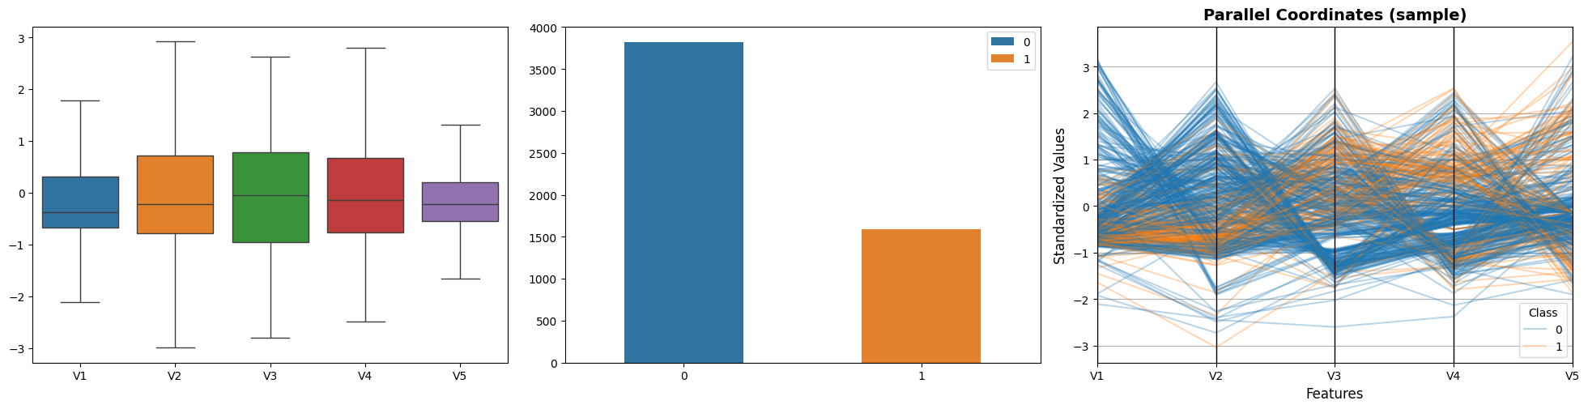
Dataset
Features are standard scaled. Classes are unbalanced (about 70/30)
Cardia F. Loddo M. N.
Phoneme Classification A Comparative Study of Machine Learning Approaches
4

Slide 5
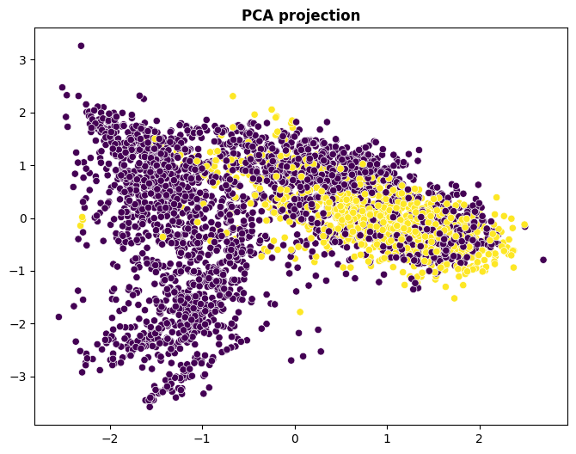
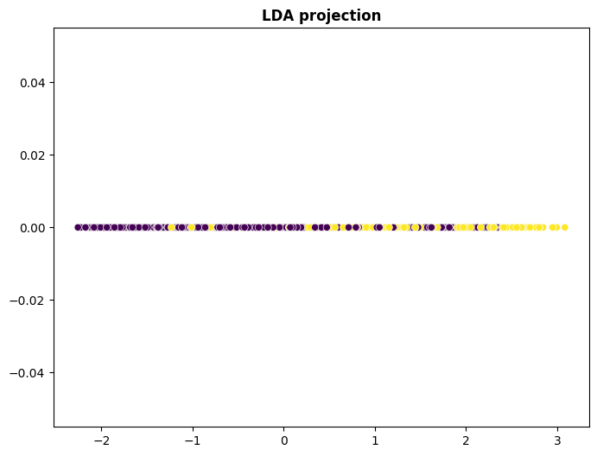
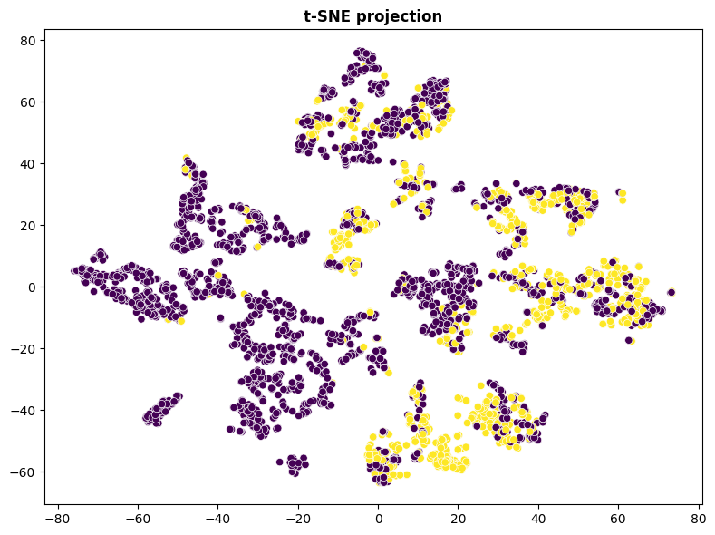
Preprocessing
We reduced data dimensionality with PCA, LDA, t-SNE
Cardia F. Loddo M. N.
Phoneme Classification A Comparative Study of Machine Learning Approaches
5

Slide 6
Preprocessing
To mitigate imbalance we undersample and oversample the training set
Configuration | Class 0 | Class 1 | Total
Original | 2863 | 1190 | 4053
Undersampling (Random) | 1190 | 1190 | 2380
Oversampling (ADASYN) | 2863 | 2908 | 5771
Cardia F. Loddo M. N.
Phoneme Classification A Comparative Study of Machine Learning Approaches
6

Slide 7
Classification
We compared the performances of several Machine Learning models including
Shallow
  Decision Tree
  Naive Bayes
  K-Nearest Neighbor
  Support Vector Machine
Ensemble
  Random Forest
  AdaBoost
  Extreme Gradient Boosting
Deep
  Multi-Layer Perceptron
Cardia F. Loddo M. N.
Phoneme Classification A Comparative Study of Machine Learning Approaches
7

Slide 8
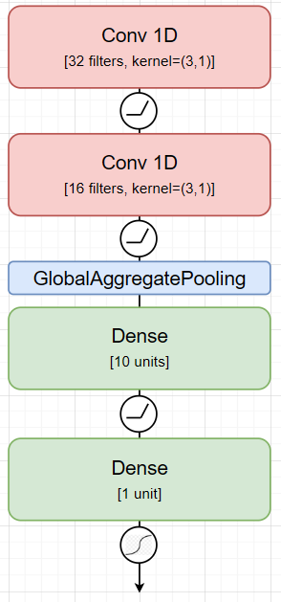
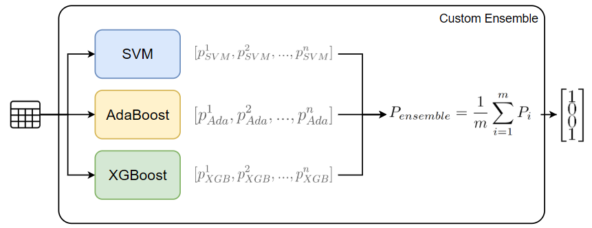
Classification
And we introduce two models designed by ourselves
Custom Ensemble
Convolutional Neural Network
Cardia F. Loddo M. N.
Phoneme Classification A Comparative Study of Machine Learning Approaches
8

Slide 9
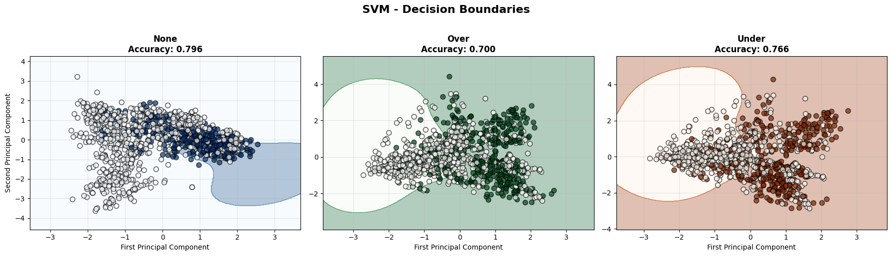
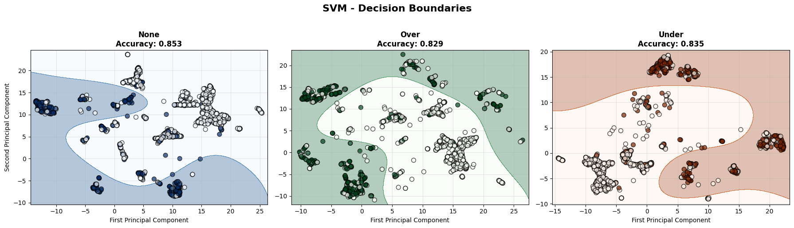
Classification
We trained all the models with original 5D data
In addition, we trained SVM with PCA and UMAP reduced 2D data
Cardia F. Loddo M. N.
Phoneme Classification A Comparative Study of Machine Learning Approaches
9

Slide 10
Evaluation & Discussion
Q1: Which classification models performed best? Why?
Rank | Model | F1-score (*)
1 | Random Forest | 0.8821
2 | Custom Ensemble | 0.8801
3 | XGBoost | 0.8791
Ensemble averaging reduces variance
Tree-based methods are less sensitive to imbalance.
10 | AdaBoost | 0.7809
11 | SVM w/ PCA | 0.7540
12 | Naive Bayes | 0.6844
PCA underperformed (see reminder)
Bayesian hypothesis may not be satisfied
Cardia F. Loddo M. N.
Phoneme Classification A Comparative Study of Machine Learning Approaches
10

Slide 11
Evaluation & Discussion
Q2: Does dimensionality reduction cause significant differences in performance?
Model | F1-score (*) | Comparison
SVM w/ PCA | 0.7540 | -14.20% vs SVM baseline
SVM w/ UMAP | 0.8389 | -2.65% vs SVM baseline
Since the dataset is already low-dimensional, dimensionality reduction causes loss of useful information, so models underperform
Cardia F. Loddo M. N.
Phoneme Classification A Comparative Study of Machine Learning Approaches
11

Slide 12
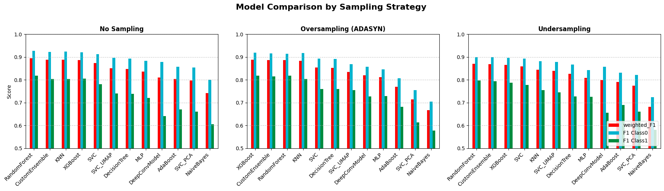
Evaluation & Discussion
Q3: Which algorithms are most sensitive to data dimensionality?
Model | F1-score (*) | Comparison
SVM w/ PCA | 0.7540 | -14.20% vs SVM baseline
SVM w/ UMAP | 0.8389 | -2.65% vs SVM baseline
Deep models, Naive Bayes, and models trained on reduced data show worse overall performances and a larger gap between class performances
Cardia F. Loddo M. N.
Phoneme Classification A Comparative Study of Machine Learning Approaches
12

Slide 13



Evaluation & Discussion
Q4: What are strengths, limitations, and extensions/alternatives of our approaches?
Preprocessing & Feature Extraction
Classification models
Tree-based ensemble models show great performances F1-score > 87%
Low dimension - minimal preprocessing
Balancing and dimensionality reduction underperform
Neural networks underfit: many parameters, few data
Perform best (hyper)parameter optimization.
Improve ensembling (voting, stacking, …)
Perform data augmentation
Cardia F. Loddo M. N.
Phoneme Classification A Comparative Study of Machine Learning Approaches
13

Slide 14

Facoltà di Scienze
Dipartimento di Matematica e Informatica
Corso di Laurea Magistrale in Informatica
Informatica Applicata e Data Analytics
Phoneme Classification
A Comparative Study of Machine Learning Approaches
Course:
Data Mining
Teacher:
Prof. Alessandro Giuliani
Candidates:
Francesco Cardia 60/99/00017
Marco Niccolò Loddo 60/99/00022
Source Code
Academic Year 2025/2026
Notes:
ciao

